Slide 1



Capstone univariates
View in Power BI
Last data refresh:
5/5/2025 3:47:17 PM UTC
Downloaded at:
5/5/2025 10:27:38 PM UTC

Slide 2
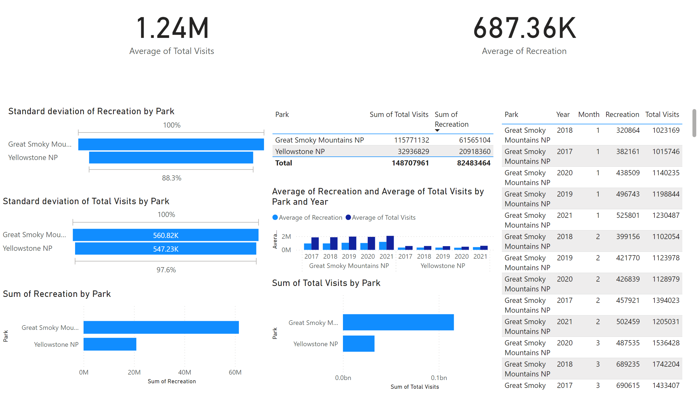
Page 1
Notes:
card
No alt text provided
card
No alt text provided
funnel
No alt text provided
funnel
No alt text provided
clusteredBarChart
No alt text provided
tableEx
No alt text provided
clusteredBarChart
No alt text provided
lineClusteredColumnComboChart
No alt text provided
tableEx
No alt text provided

